Slide 1




Research Presentation

Slide 2
Recap Last Class

Slide 3

Chapter 9: Collecting Descriptive Primary Data – Learning Objectives
Cite three major purposes of descriptive research
List the six specifications of a descriptive study
Discuss the difference between cross-sectional and longitudinal designs
Explain what is meant by a panel in marketing research, and explain the difference between a continuous
Describe the emphasis in sample surveys
List the kinds of demographic and socioeconomic characteristics that interest marketers
Cite the three main approaches used to measure awareness

Slide 4
Three Purposes of Descriptive Research
Describe the characteristics of certain groups
Estimate the proportion of people who behave in a certain a certain way
Make specific predictions
Exploratory research is very flexible; descriptive research is MUCH more rigid
Descriptive research requires the clear specification of WHO, WHAT, WHEN, WHERE, WHY, HOW before data collection can begin

Slide 5
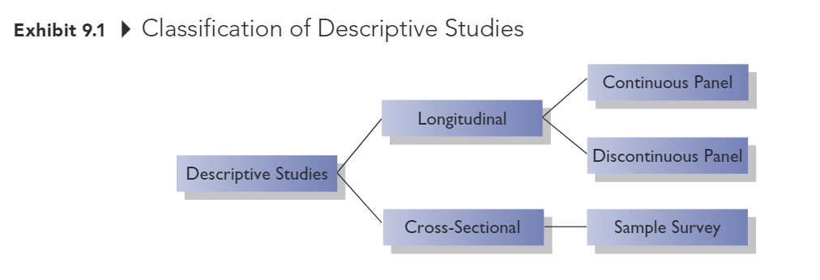
Classification of Descriptive Studies

Slide 6
Classification of Descriptive Studies
Longitudinal study: Investigation involving a fixed sample of elements that is measured repeatedly through time
Continuous panel: A fixed sample of respondents who are measured repeatedly over time with respect to the same variables
Discontinuous panel: A fixed sample of respondents who are measured repeatedly over time but on variables that change from measurement to measurement
Cross-sectional study: Investigation involving a sample of elements selected form the population of interest that are measured at a single point in time
Sample Survey: Cross-sectional study in which the sample is selected to be representative of the target population and in which the emphasis is on the generation of summary statistics such as averages and percentages

Slide 7
Types of Primary Data
Demographic/socioeconomic characteristics
Personality/lifestyle characteristics
Attitudes
Awareness/knowledge
Intentions
Motivation
Behavior

Slide 8
Demographic/Socioeconomic Characteristics
Often used to divide a population into groups (e.g., for market segmentation purposes)
Some commonly measured variables:
Age
Income
Occupation
Education
Gender
Ethnicity

Slide 9
Personality/Lifestyle Characteristics
Personality: normal patterns of behavior exhibited by an individual; the attributes, traits, and mannerisms that distinguish one individual from another
Lifestyle: How individuals live, what interests them, their values, and what they like

Slide 10
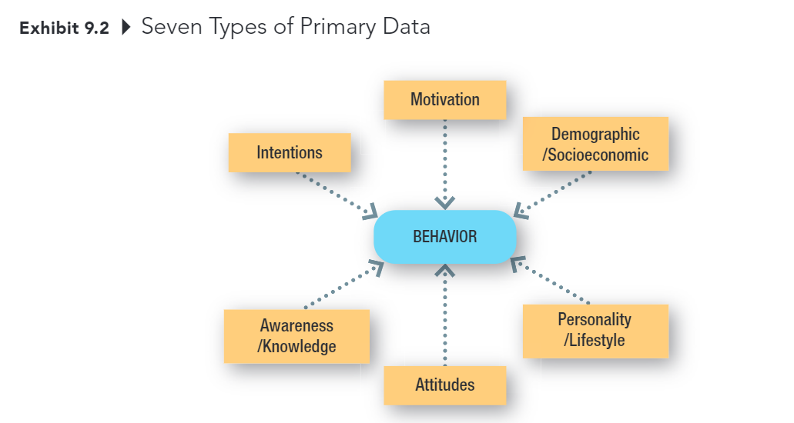
Types of Primary Data

Slide 11
Attitudes
An attitude is an individual's overall evaluation of something
Marketers often measure people’s attitudes toward companies, products, and services. They also measure may “attitude-like” variables including value, quality, and satisfaction.

Slide 12
Awareness/ Knowledge
Insight into, or understanding of facts about, some object or phenomenon.
Marketers often want to know what individuals know or believe about products, brands, companies, advertisements, and so on.

Slide 13
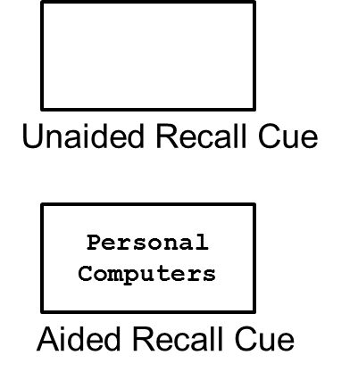
Measuring Awareness
Unaided Recall: For what products and brands do you remember seeing ads?
Aided Recall: Do you remember seeing ads for personal computers?

Slide 14
Intentions
Anticipated or planned future behavior
Marketers often need this type of information to assess demand for a product or service
Estimating demand for products and services accurately is one of the most difficult tasks a marketing researcher faces
Notes:
Definitely would buy
Probably would buy
Undecided
Probably would not buy
Definitely would not buy

Slide 15
Motivation
A need, a want, a drive, a wish, a desire, an impulse, or any inner state that energizes, activates, moves, directs, or channels behavior toward goals
If we understand what drives consumer behavior, we are in better position to anticipate consumer needs and offer products and services that satisfy those needs.

Slide 16
Behavior
What subjects have done or are doing
Behavioral data might be obtained by observing behaviors or by asking consumers to remember and report their past behaviors.

Slide 17
Chapter 10: Collecting Data by Observation – Learning Objectives
Describe the two basic means of obtaining primary data
State the specific advantages of each method of data collection
List the important considerations in the use of observational methods of data collection
Explain the difference between structured and unstructured observation.
Cite the main reason researchers may choose to disguise the presence of an observer in a study
Explain the advantages and disadvantages of conducting an observational experiment in a laboratory.
List several approaches to mechanical observation

Slide 18
Two Methods of Data Collection
Communication
A method of data collection involving questioning respondents to secure the desired information using a data collection instrument called a questionnaire.
Observation
A method of data collection in which the situation of interest is watched and the relevant facts, actions, or behaviors are recorded

Slide 19
Communication vs. Observation
Attribute | Communication | Observation
Versatility | 4
Speed | 4
Cost | 4
Objectivity |  | 4
Accuracy |  | 4

Slide 20
Why use observation research?
Observation is often the best method for generating valid data about individual’s behavior.
E.g., using communication methods we can ask a consumer to estimate how many jars of peanut butter he purchased at a particular store in the past year. With observation research, we can KNOW how many jars he purchased at that store in the past year.

Slide 21
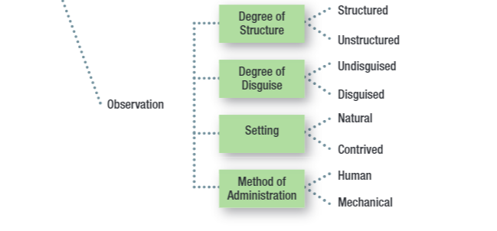
Key Issues for Collecting Information by Observation

Slide 22
Structured Observation
Structure: The degree of standardization used with the data collection instrument.
Method of observation in which the phenomena to be observed (typically behaviors) can be defined precisely along with the categories used to record the phenomena.

Slide 23
Unstructured Observation
Method of observation in which the researcher has a great deal of flexibility in terms of what to note and record.

Slide 24
Disguise
The amount of knowledge people have about a study in which they are participating

Slide 25
Disguised vs Undisguised Observation
With disguised observation, subjects are not aware that they are being observed
Ethical considerations -> Debriefing
With undisguised observation, subjects are aware that they are being observed

Slide 26
Natural Setting
Subjects are observed in the environment where the behavior normally takes place
Shopping in a store
Using or consuming a product at home

Slide 27
Contrived Setting
Subjects are observed in an environment that has been specially designed for recording their behavior
Fake store
Computer simulation

Slide 28
Human vs. Mechanical Observation
With human observation, individuals are trained to systematically observe a phenomenon and to record the observational form the specific events that take place
With electrical or mechanical observation, an electrical or mechanical device observes a phenomenon and records the events that take place.
E.g., Video cameras, bar code scanners, response latency, Galvanometer, voice-pitch analysis, eye camera.

Slide 29
Chapter 11: Collecting Data by Communication
Explain the concept of structure as it relates to questionnaires
Cite the drawbacks of using high degrees of structure
Explain what is meant by disguise in a questionnaire
Discuss two situations in which disguise might be desirable
Differentiate among the main methods of administering questionnaires
Discuss three important aspects used to compare the four different methods of administering questionnaires.

Slide 30
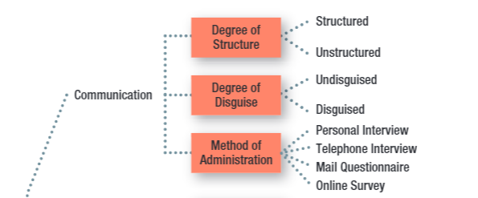
Key Issues for Collecting Information by Communication

Slide 31
Key Issues for Collecting Information by Communication
Fixed-Alternative Questions: Questions in which the responses are limited to stated alternatives
Open-ended question: a question in which respondents are free to reply in their own words rather than being limited to choosing from among a set of alternatives.
Notes:
Structure: the degree of standardization used with the data collection instrument

Slide 32
High Structure: Advantages and Disadvantages
Attribute | Disadvantage | Advantage
Ease of Administration |  | 4
Ease of Coding and Analysis |  | 4
Measure Reliability |  | 4
Response Bias:
Forced choice | 4
Omitted response | 4
Precision of response | 4

Slide 33
The Ethics of Disguise
Disguise: the amount of knowledge people have about a study in which they are participating
Under the rights model of ethics, the use of disguise amounts to a violation of the respondent’s right to know
Debriefing: The process of providing appropriate information to respondents after data have been collected using disguise
Notes:
Disguise is especially use when
Knowing the purpose or sponsor is likely to bias respondent’s’ answers
Re-creating the natural environment is necessary, particularly in experimental research

Slide 34
Primary Methods of Administration
Personal Interviews
Telephone Interviews
Mail Surveys
Online Surveys

Slide 35
Personal Interview
Direct, face-to-face conservation between a representative of the research organization, the interviewer, and a respondent or interviewee
Can be conducted in lots of different locations (including malls using mall intercepts)
Generally strong sampling control (including higher response rates)
Great flexibility, but higher levels of interviewer bias
Time and cost-intensive

Slide 36
Survey Types
Random-digit Dialing (RDD): A technique used in studies using telephone interviews, in which the numbers to be called are randomly generated
In-bound surveys: A method of data collection in which respondents access a survey by telephone or on the Web to respond to survey items.

Slide 37
Mail Survey
A survey administered by mail to designated respondents with an accompanying cover letter. The respondents return the questionnaire by mail to the research organization.
Lower degree of sampling control (mailing lists often available, but no control over who completes survey, and often low response rates)
No interviewer bias and can offer anonymity, but less flexibility (no explanation or follow-up, no complex materials)
Lower cost than personal or telephone interviews.
Notes:
In real world,
Personal interviews 67%
Telephone 61%
Paper-based survey 32% Online survey 97%

Slide 38
Online Survey
A method of administration that relies on the web for completing the survey
Explosion in use over the past decade
Email lists and panels are readily available, but it’s difficult to know how you are really contacting, response rates are often very low
Good flexibility: visuals and complex material possible
Usually quick and inexpensive

Slide 39
Recap

Slide 40
5-min snippet

